Slide 1
Urinary System Diseases Diagnosis Using
Machine Learning Techniques
-By Group 6

Slide 2
Introduction
The urinary system, which includes kidneys, bladder, ureters, and urethra, is the major organ responsible for filtration of blood. The study considers both diseases affecting the urinary system: urinary bladder inflammation and nephritis of renal pelvis origin.
Machine learning techniques show promise in diagnosis, we have implemented Artificial neural network and Support vector machine.
The experimentation is conducted on the "Acute Inflammations Data Set" database obtained from the UCI Machine Learning Repository.

Slide 3
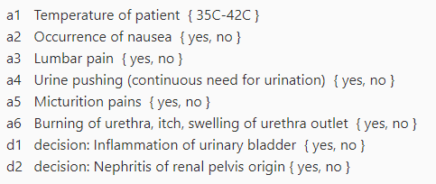
Dataset
120 samples
6 features
1 Continuous
5 Categorical (Yes/No)
2 outputs
Both Categorical (Yes/No)
These samples were randomized with random_state=42 and split 80/20 into training and validation sets that were used in our algorithms

Slide 4
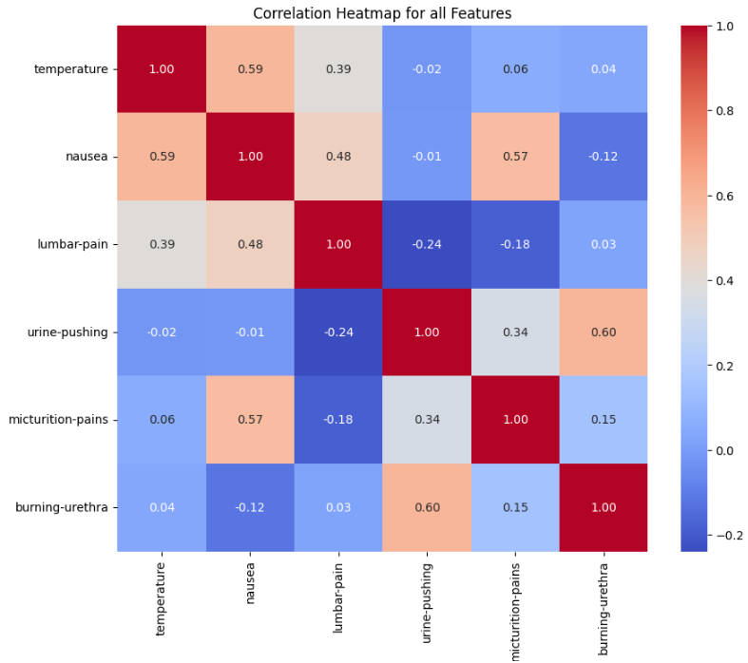
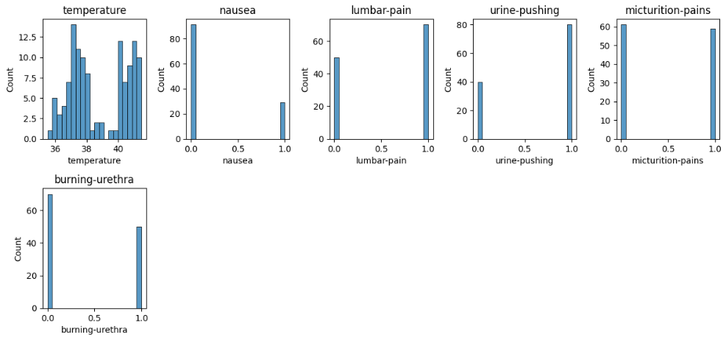
Data Visualization

Slide 5
Method - SVM
Implemented One-vs-Rest algorithms
Trained one SVM model for Inflammations and another for Nephritis
To create these models we used the SKLearn SVM library functions

Slide 6
SVM - Overfitting
By default SKLearn uses these default parameters for SVM:
C = 1
Kernel = radial basis function (rbf)
Gamma = 1/n_features * X.var()
These parameters caused our algorithm to overfit, causing the model to only predict ‘0’ or for all test cases

Slide 7
SVM - Choosing the Training Parameters
Using GridSearchCV we were able to test multiple parameters at once
This gave us the parameters
C = 1
Gamma = 1
Using these parameters we were able to find a correct fit for our model

Slide 8
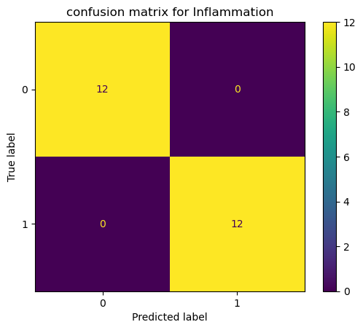
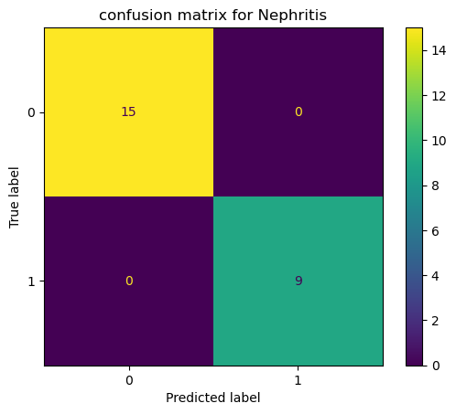
Results - SVM

Slide 9
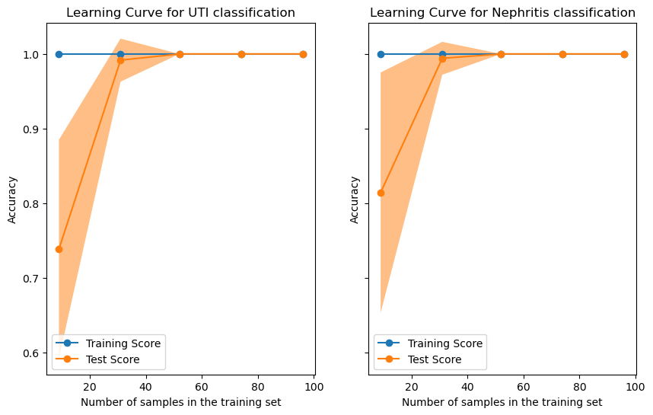
Results - SVM

Slide 10
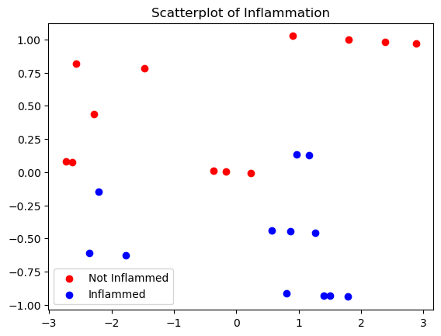
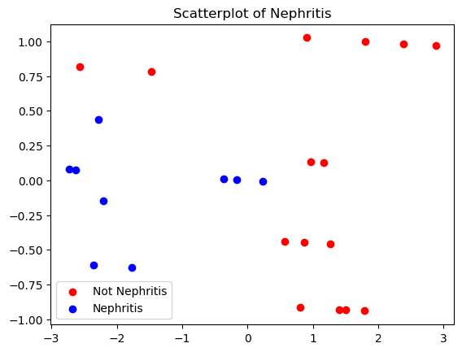
Results - SVM

Slide 11
Method - MLP
MLP is a type of feedforward artificial neural network composed of multiple layers of nodes (neurons). It consists of an input layer, one or more hidden layers, and an output layer. Each node in one layer connects to every node in the next layer, forming a fully connected network.
The architecture of the MLP classifier is specified by the hidden_layer_sizes parameter, which determines the number of hidden layers and the number of nodes in each hidden layer.The implemented model has 2 hidden layers with 64 and 32 nodes, respectively.

Slide 12
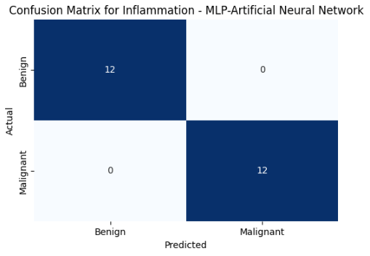
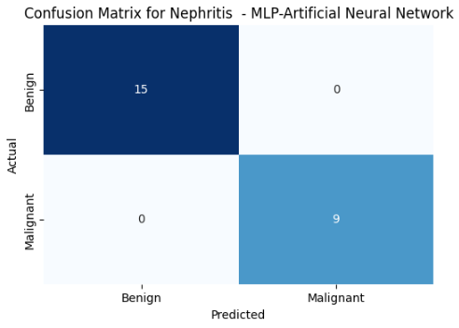
Results - MLP

Slide 13
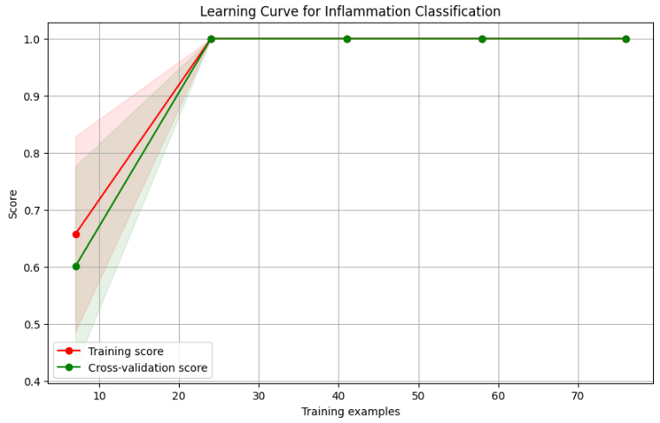
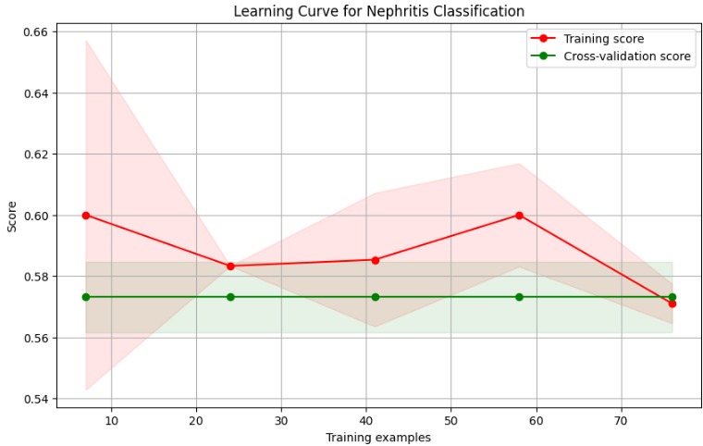
Results - MLP

Slide 14
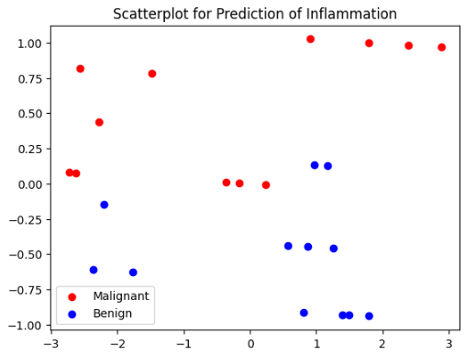
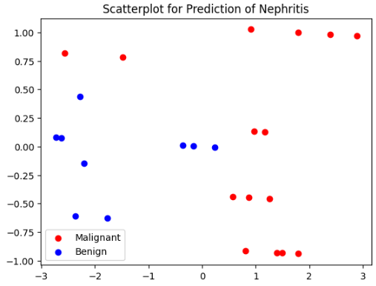
Results - MLP

Slide 15
Conclusion
In this project, we used Multi-Layer Perceptron (MLP) classifiers and Support Vector Machine (SVM) models to predict inflammation and nephritis using a dataset from the UCI Machine Learning Repository.
The structured MLP classifier with two hidden layers of 64 and 32 nodes showed promising performance, while SVM, known for its robust classification capabilities, showed competitive accuracy in classifying various medical conditions and confirms its potential, and provides reliable support for diagnosis and patient management.
Refining and analyzing model standards can improve their performance, contributing to clinical decision-making and improving patient outcomes.

